Slide 1



Building an AI Agent with Sovereignty in Mind
Towards the Next-Gen European Cloud
Open Platforms & Digital Sovereignty
9th december 2025
Tan Do Van

Slide 2
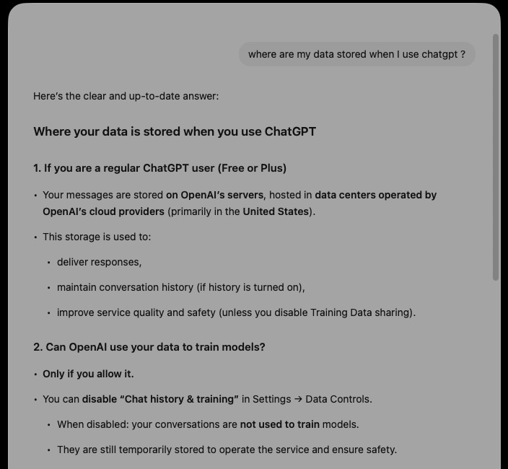

The life of “AI data packet”

Slide 3

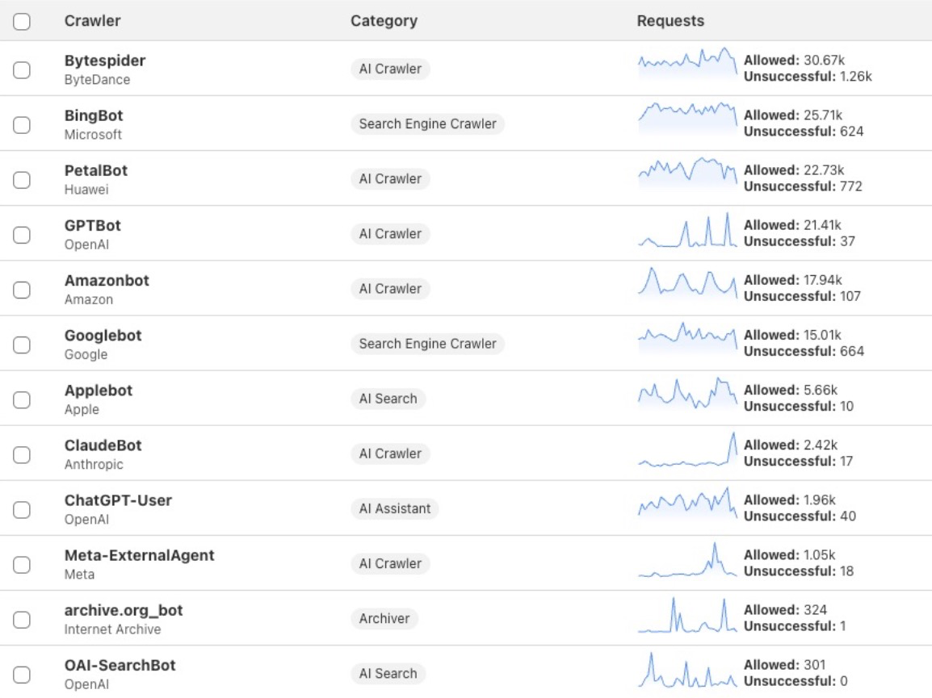
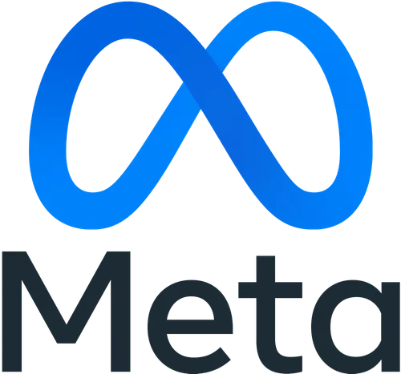

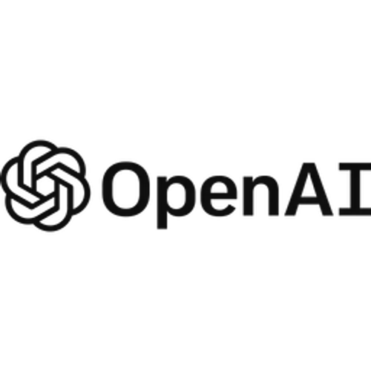


When AI Meets the Web Crawler
LLM Training
LLM Training
LLM Training
LLM Training
LLM Training
LLM Training

Slide 4

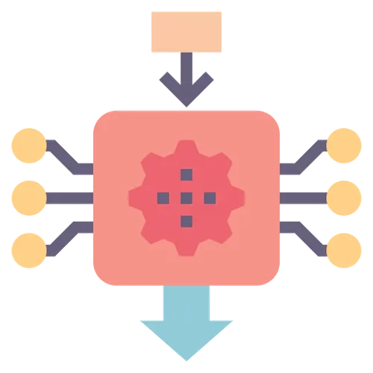



What is the Problem statement ?
AI systems need data mobility and scalability,
… while data sovereignty demands data immobility and control.
The challenge is how to balance both
enabling AI while keeping data local, secure, and compliant.
Data Location & Jurisdiction
AI Model Training & Inference
Trust & Control
Vendor Lock-In
Compliance & Auditability
Laws require that sensitive or personal data remain within national or regional borders, but many AI tools operate in foreign clouds.
AI models often need to train or infer on massive datasets, potentially transferring data across borders.
Organizations lack visibility into how data is processed inside black-box AI systems.
Most high-performance AI models (e.g., GPT, Claude) depend on US cloud providers, reducing local autonomy.
AI workflows often fail to meet strict audit or traceability requirements.

Slide 5


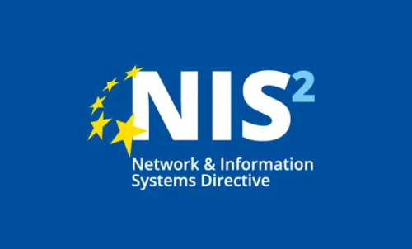

Regulations Must Evolve at the Speed of Innovation
Data Act
EU AI Act
ASEAN - Guide on AI Governance and Ethics
Singapore - Model AI Governance Framework
Malaysia - PDPA
UNESCO Recommendation on the Ethics of AI
China - PIPL
EU Cloud Code of Conduct (Cloud-CoC)
NIS2 Directive
ASEAN - Generative AI Guide
South Korea - Basic Act on AI
Australia - Privacy Act Overhaul
OECD AI Principles
Thailand - PDPA
Data Governance Act (DGA)
India - DPDP Act
GDPR
US Cloud Act
Japan - APPI
Indonesia - PDPL
2018
2019
2020
2021
2022
2023
2024
2025

Slide 6
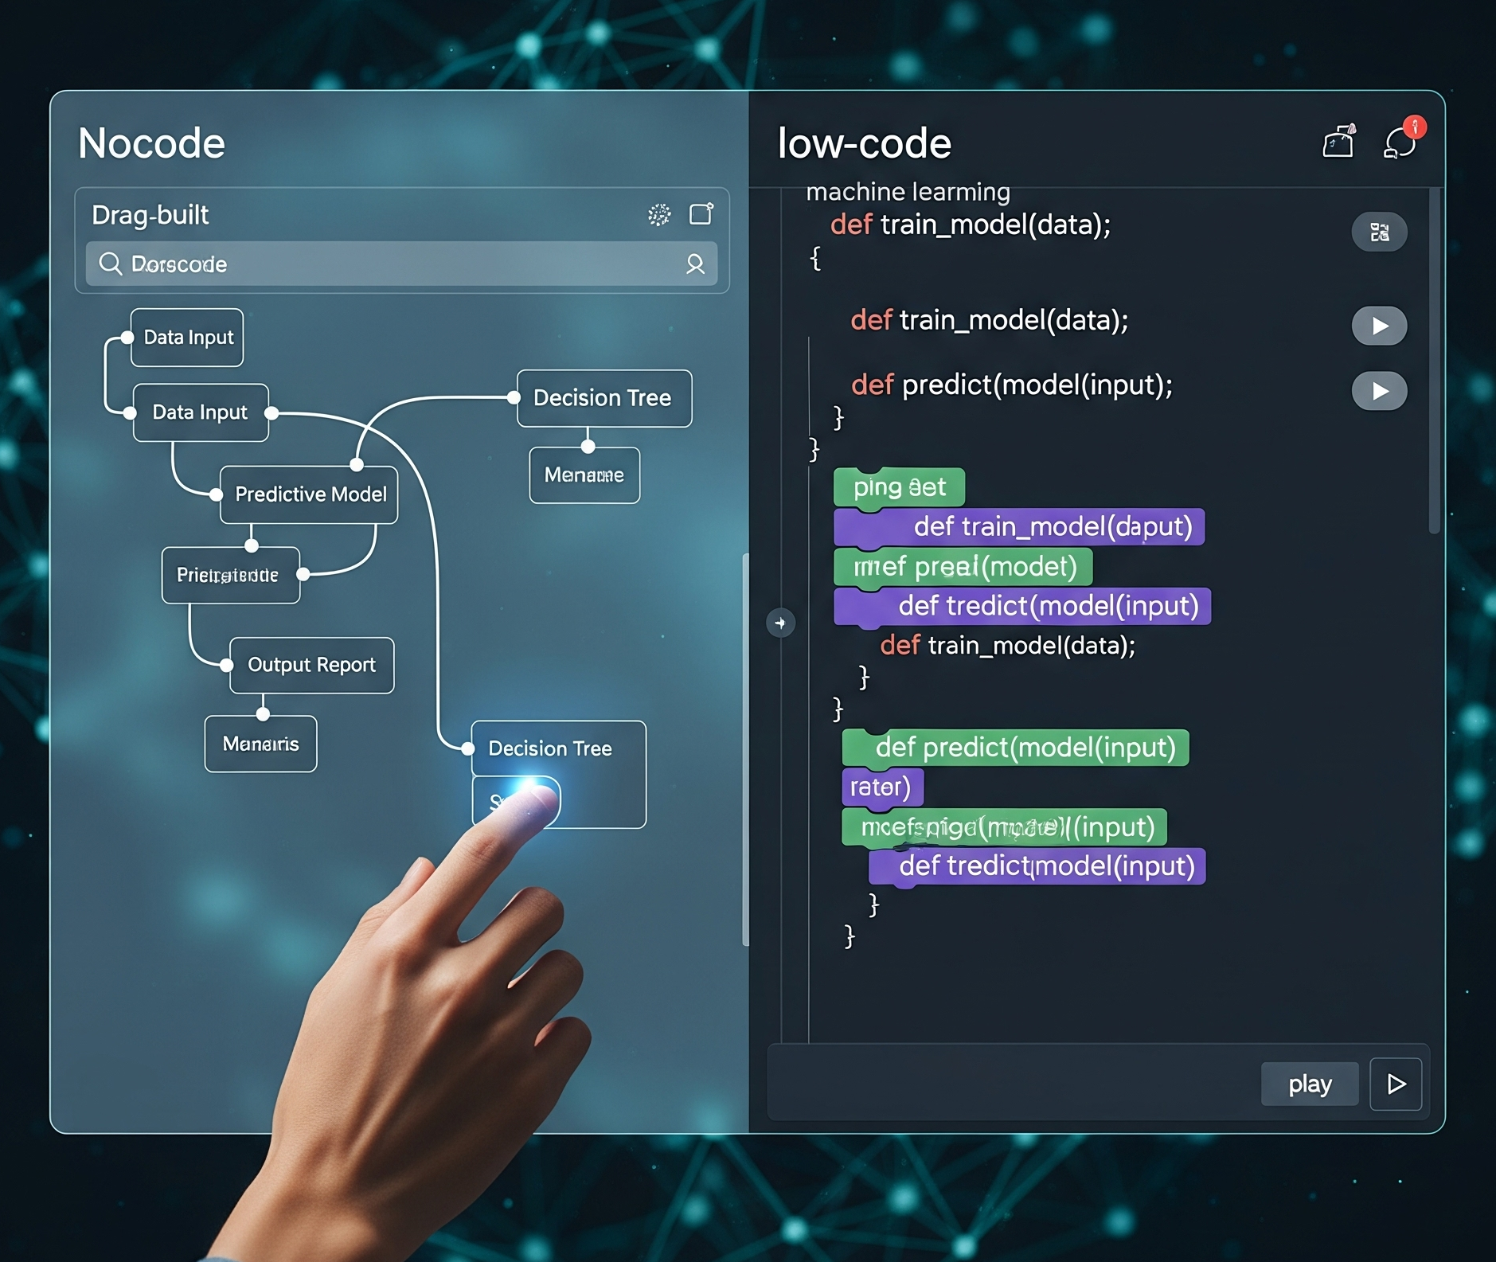
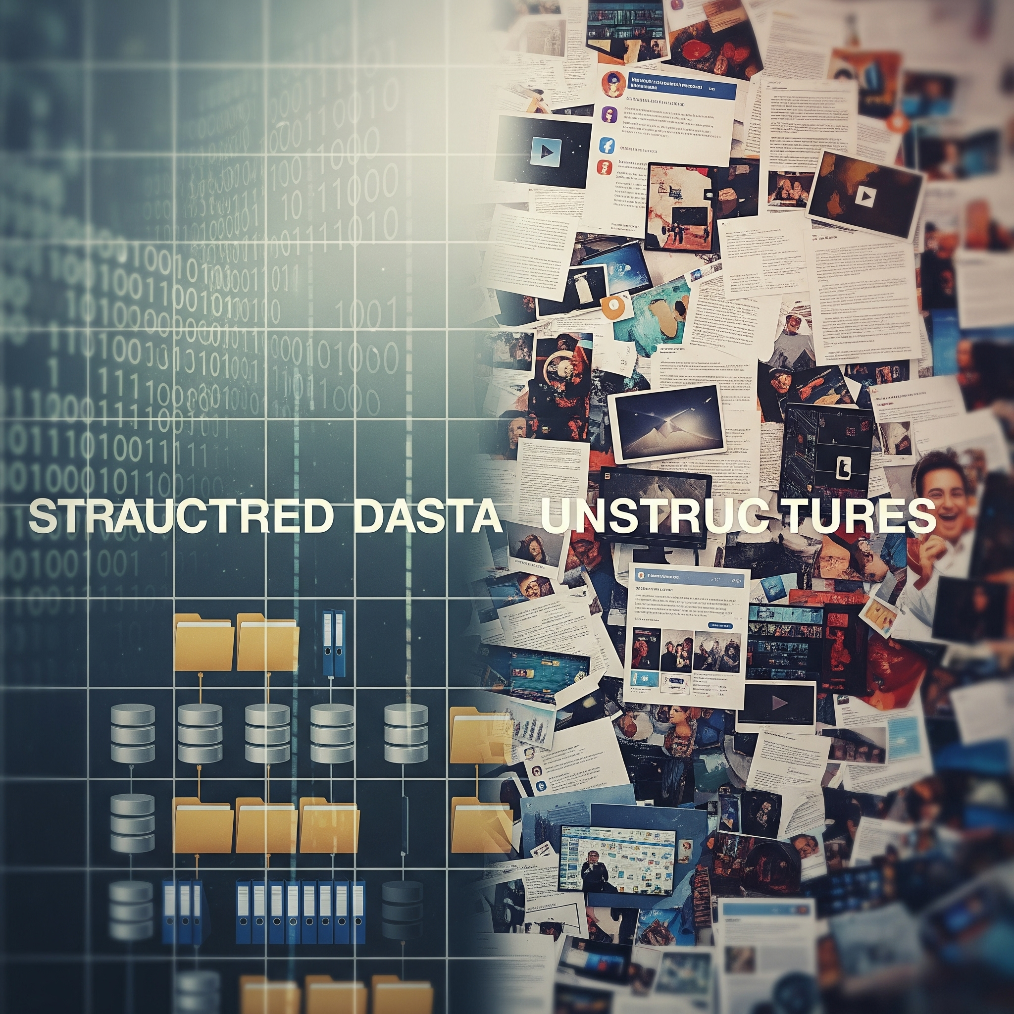


Things you need to build a AI App
AI Apps platform
(no-low code)
Data
(Structure / unstructured)
Models
GPU

Slide 7










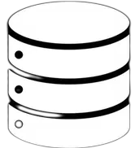


Build a AI Agent self-hosted | End 2 end flow
Corporate Unstructured and Structured data
2.Structure aware (chunk)
4. Vector db creation
6. Observability
1
2
RAG
3
4
5
6
VectorDB
1.Data restructuring
3.Metadata Creation
5. AI Chatflow agent

Slide 8
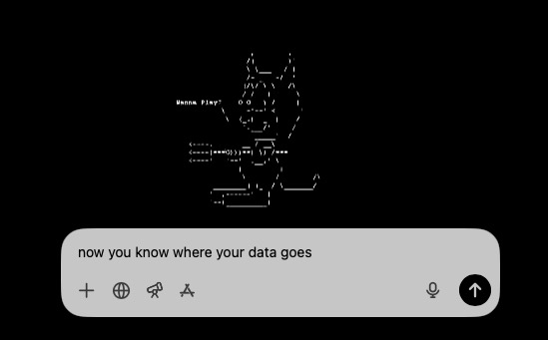
Key takeway
✅ 100% data sovereignty
Up to you…
🔒 Build your AI Data strategy first
🚀 Build your Model-aaS strategy
🔄 Avoid vendor-lock in
⚠️ Educate against “Shadow-AI”

Slide 9
Thank you

